Slide 1

gradio: create and share a visual frontend for your ML models
Abubakar Abid (a12d@stanford.edu)
Ali Abdalla
Ali Abid
Dawood Khan
James Zou
CS231n
19 April 2019

Slide 2
Does a high test accuracy == a good model?

Slide 3


Good for whom?
Machine Learning Developers
Collaborators/End Users

Slide 4

State of the art image classifiers trained on ImageNet:
bride, dress, woman
performance, costume
https://www.nature.com/articles/d41586-018-05707-8

Slide 5
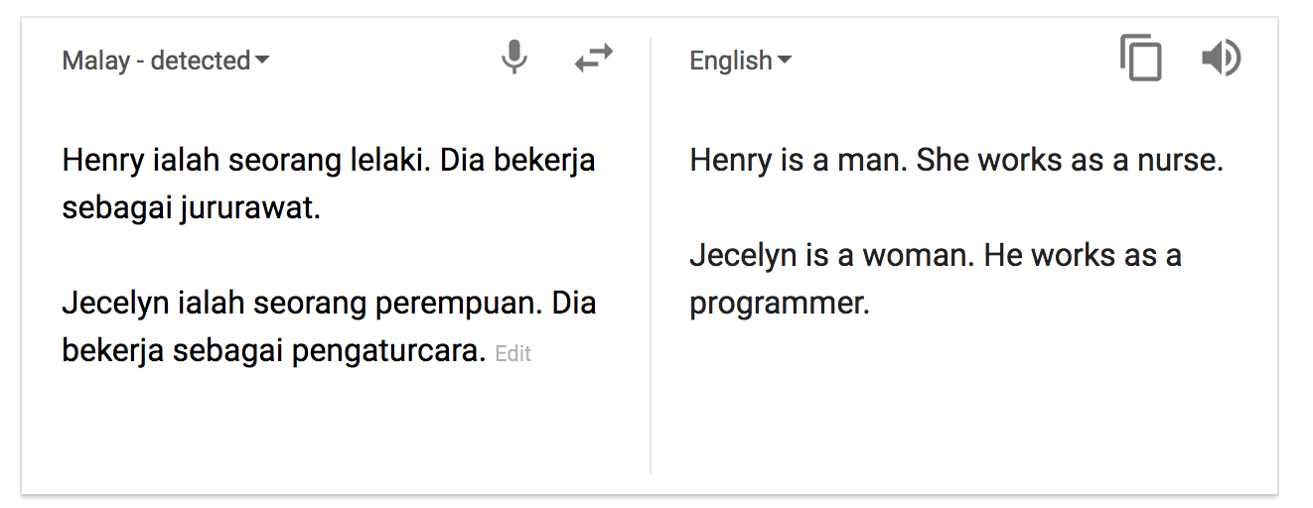
Google Translate, until recently:
https://hackernoon.com/bias-sexist-or-this-is-the-way-it-should-be-ce1f7c8c683c

Slide 6
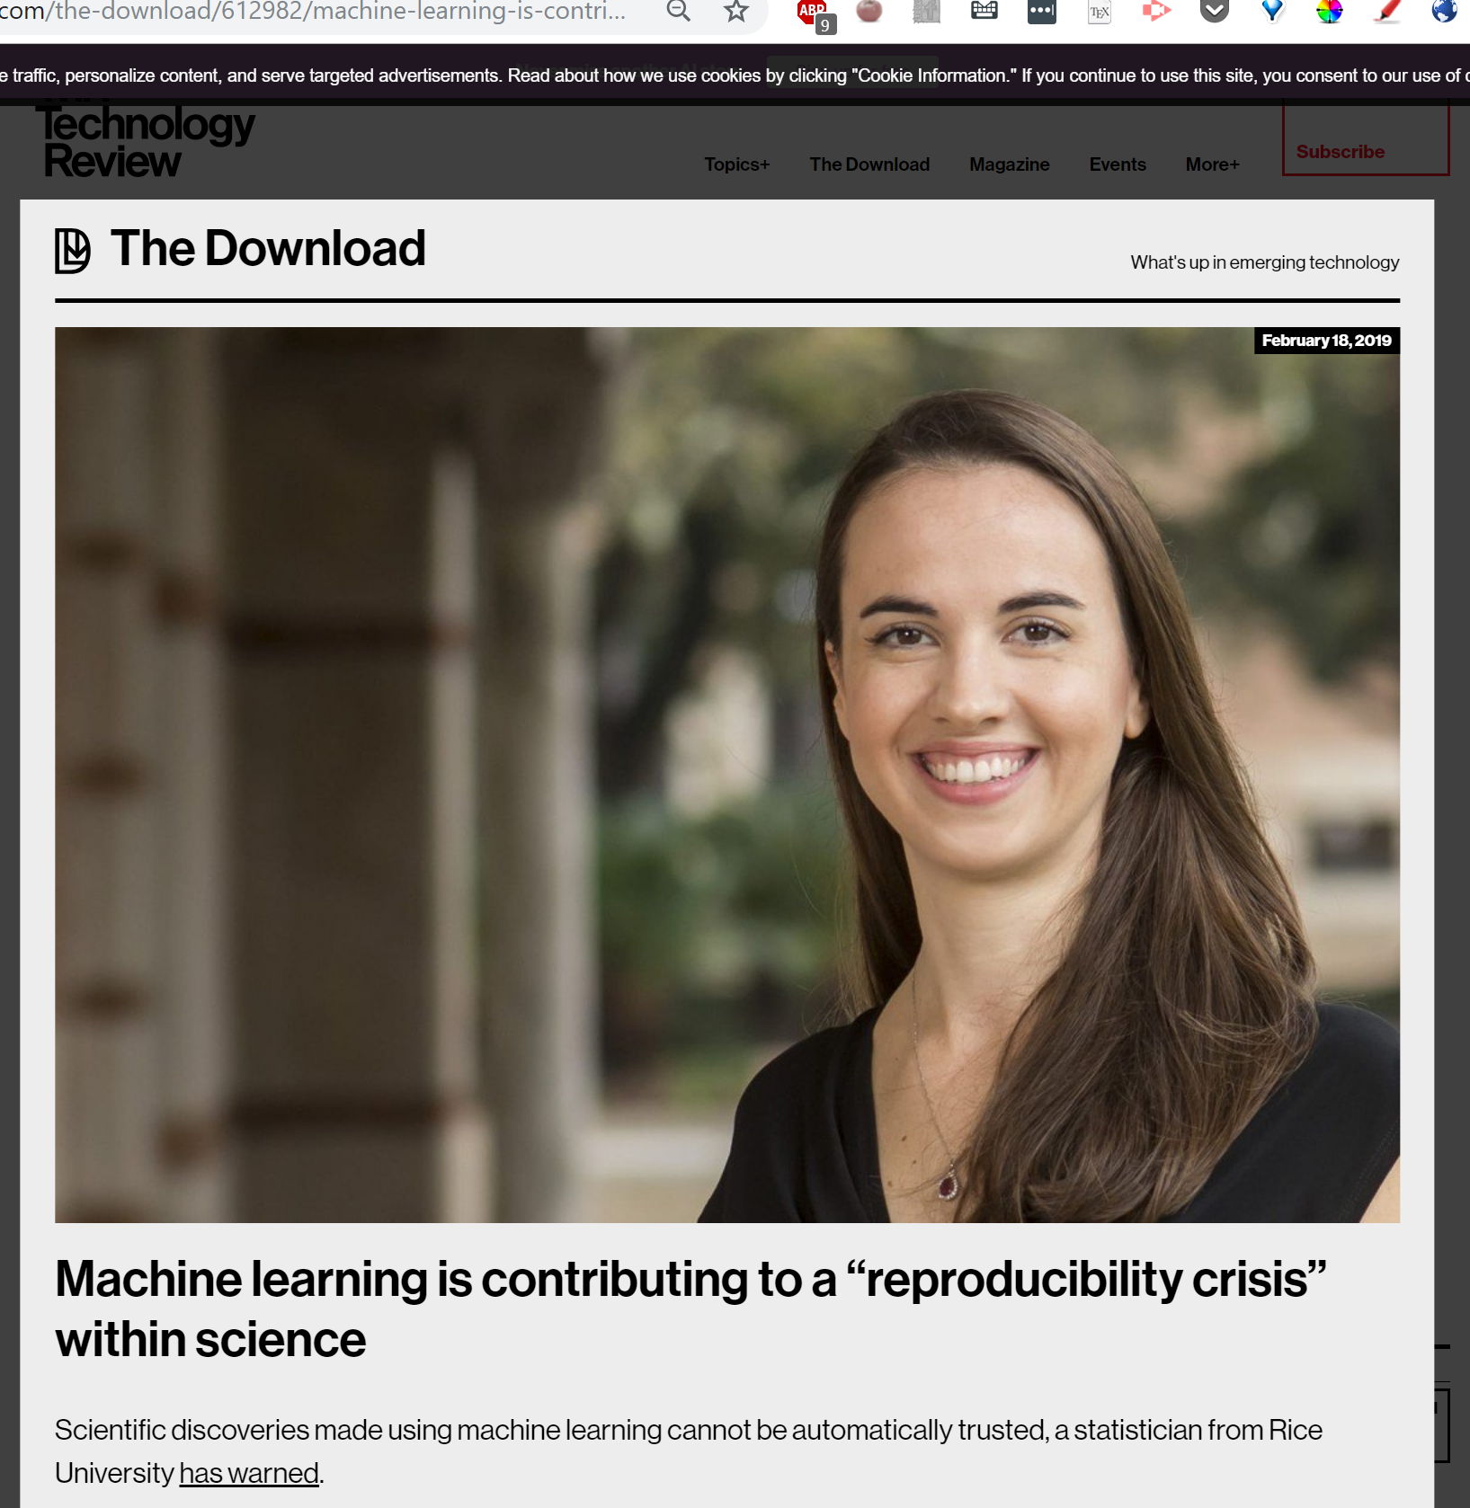

Slide 7
Why do so many models not reliable in the wild?

Slide 8
Difficult for end users to access models
Machine Learning Developer
Collaborators/End Users

Slide 9
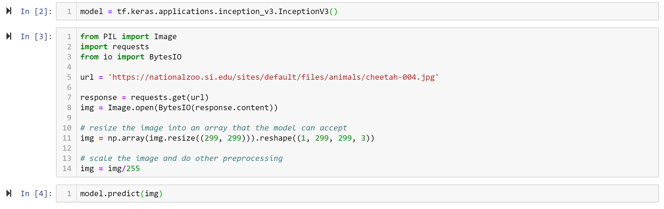
Interacting with ML models requires coding...

Slide 10
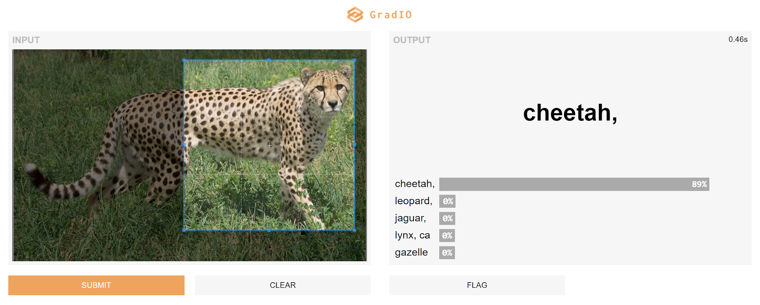
With gradio:

Slide 11
gradio (gradient input output)
gradio allows you to:
rapidly create visual interfaces on top of your model

Slide 12
gradio (gradient input output)
gradio allows you to:
rapidly create visual interfaces on top of your model
share them with others without dealing with hosting

Slide 13
Example Usage

Slide 14
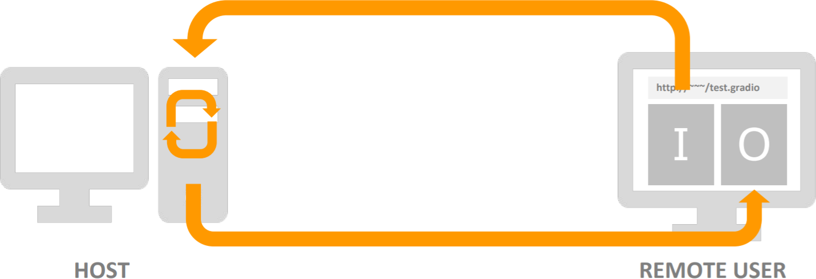
gradio (gradient input output)
gradio allows you to:
rapidly create visual interfaces on top of your model
share them with others without dealing with hosting
get feedback

Slide 15
Example Usage

Slide 16
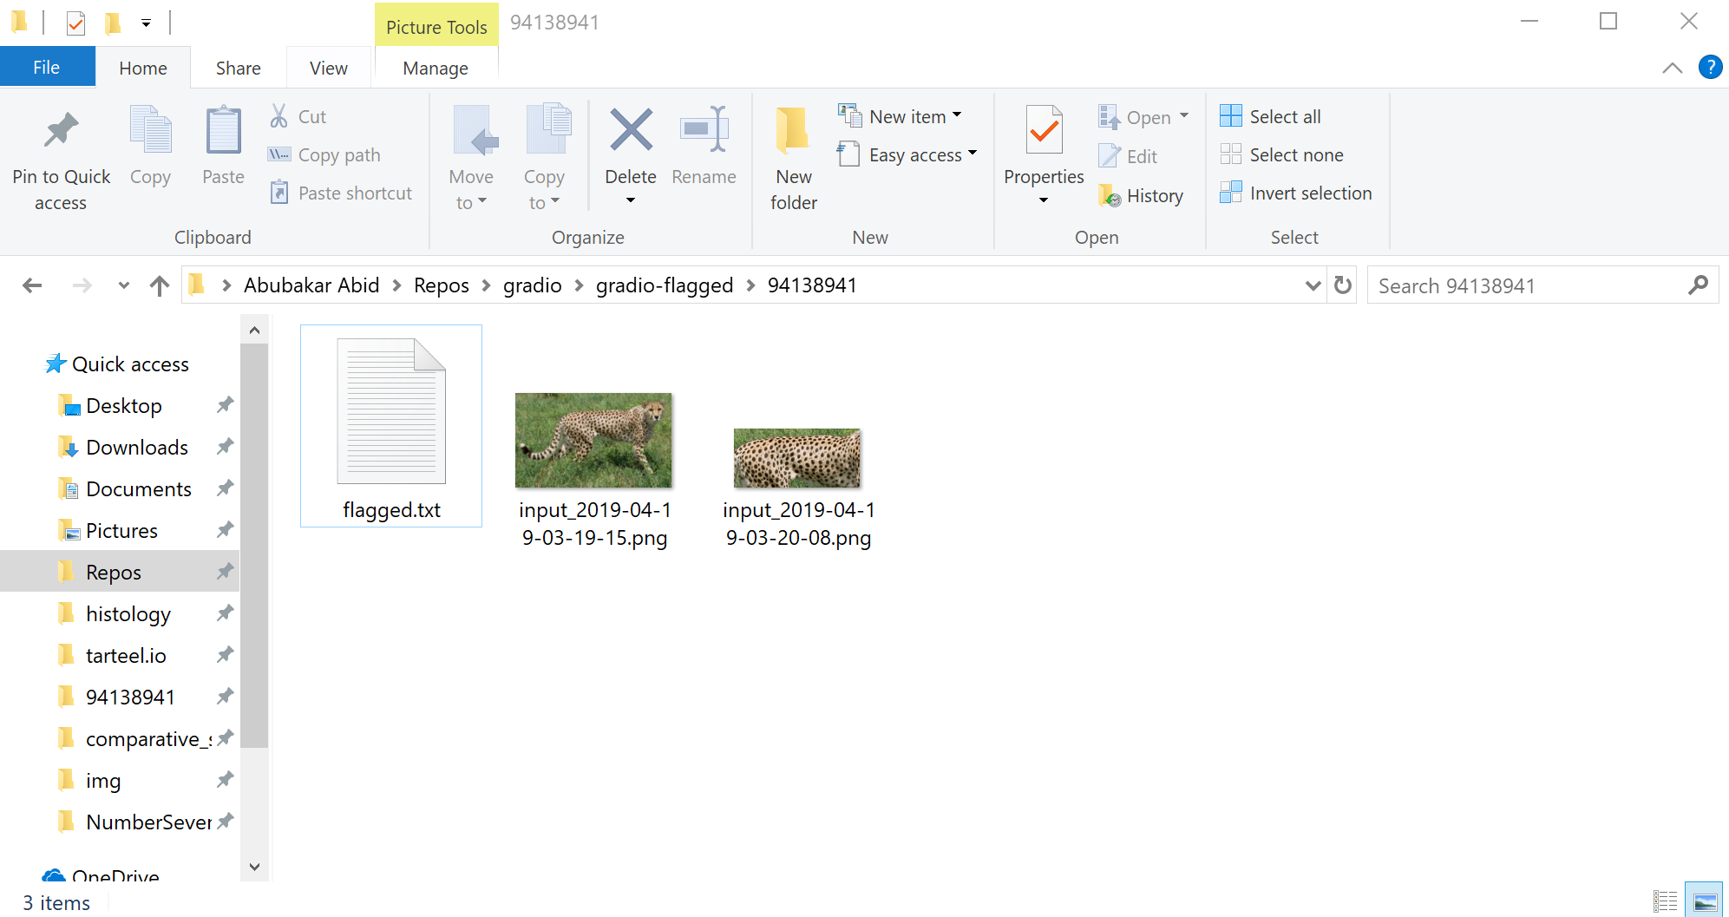
Saves the flagged input to developer’s machine

Slide 17
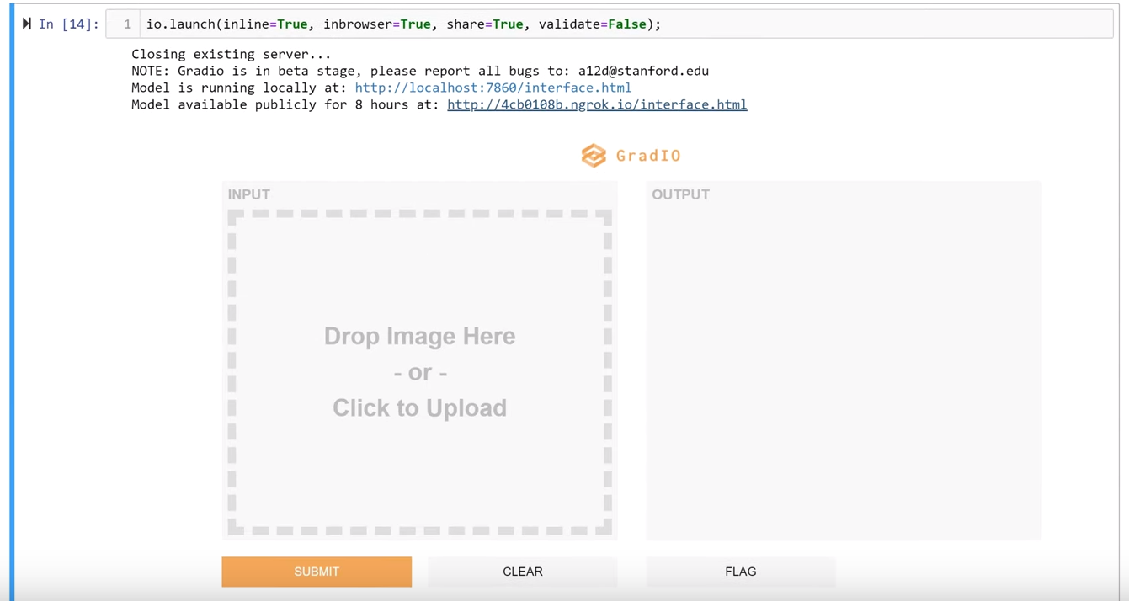
Other nice features: embedding

Slide 18
DEMO
pip install gradio
Documentation: www.gradio.app

Slide 19
Takeaways
gradio is library for interacting with trained machine learn models and sharing them.
We hope it can help more reliable models
To use it, simply: pip install gradio
www.gradio.app
(sign up for email updates)

